Slide 1
TapSwitch
Team: Funky Clydesdales

Slide 2
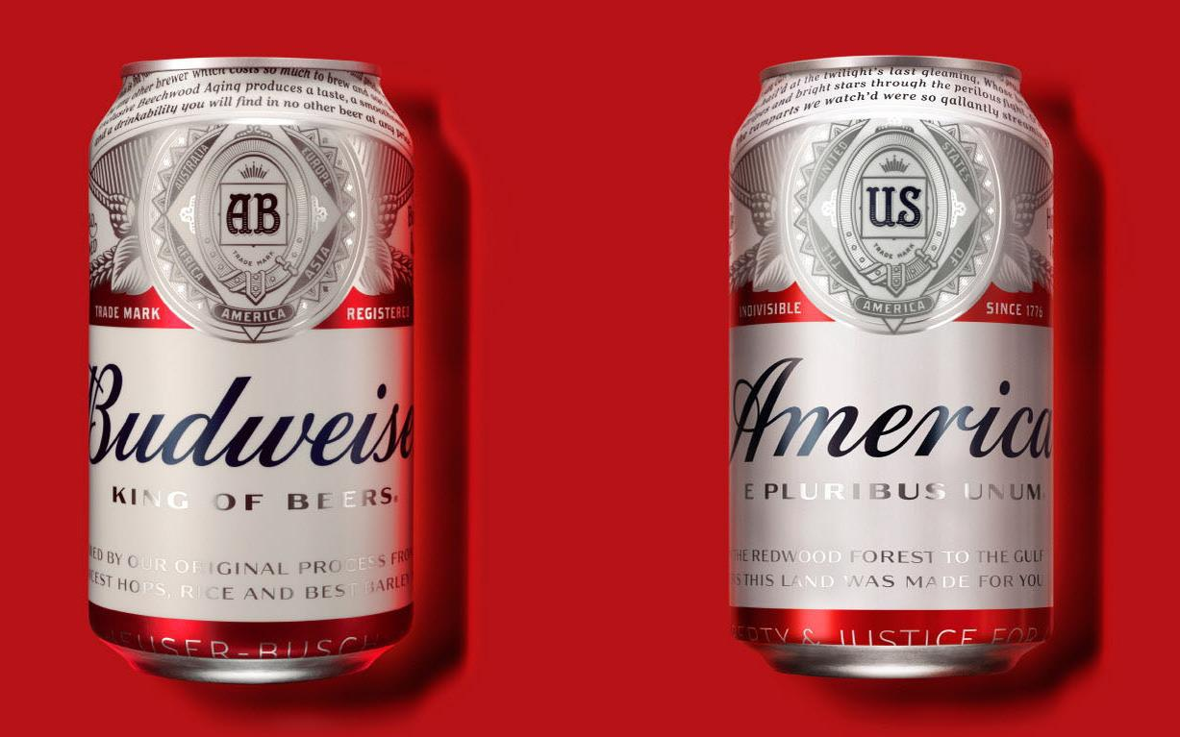
The Problem

Slide 3

Consumption by brand
Consumption by date (patterns in seasonality)
Consumption per line
Consumption against weather patterns
The Approach

Slide 4
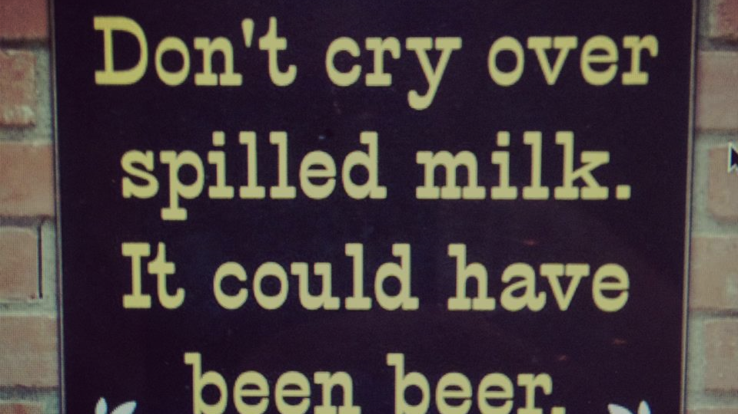
The Pain Points

Slide 5
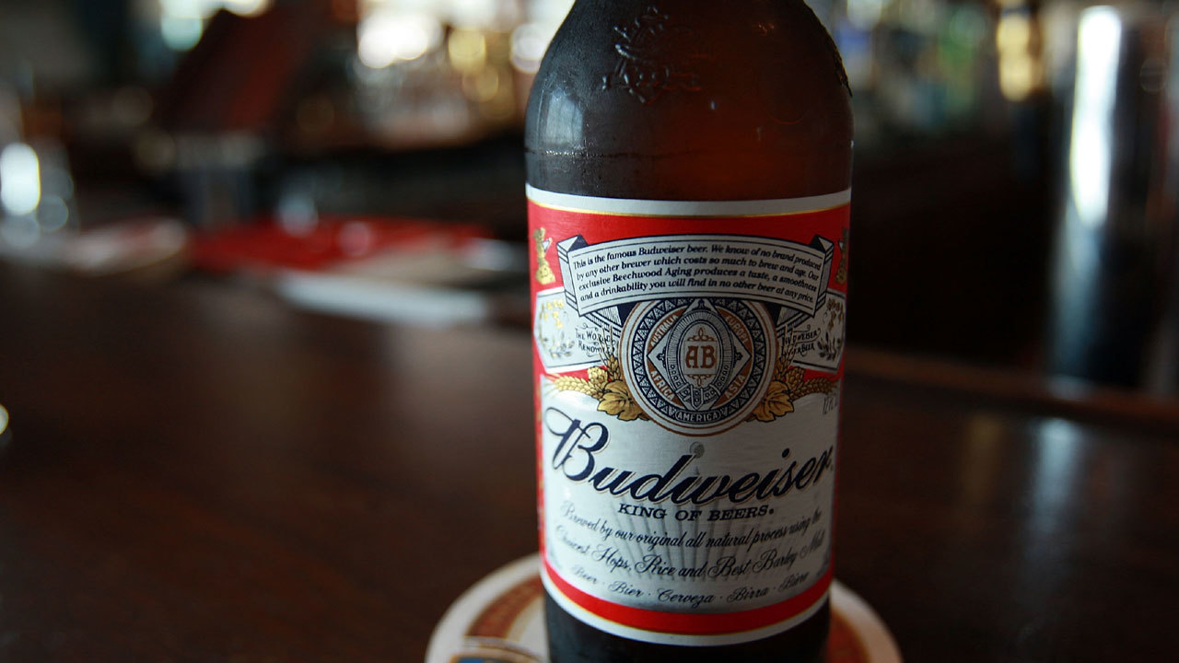
The Solution

Slide 6
The Solution:
Design an automated reordering suggestion system based on expected consumption from historical performance as well as external factors
Spur action by prompting the user to reorder via TapWeiser app, text “easy ordering”, or contacting sales representative
Allow for ABInBev greater control of push marketing initiatives

Slide 7
Consumption
Beer 1: Score 1
Beer 2: Score 0
Weather
Beer 1: Score 2
Beer 3: Score 1
Offer Adjustment
Beer 1: Score 2
Beer 2: Score 1
Beer 3: Score 1
Beer 2: Score 1
Beer 3: Score 2

Slide 8
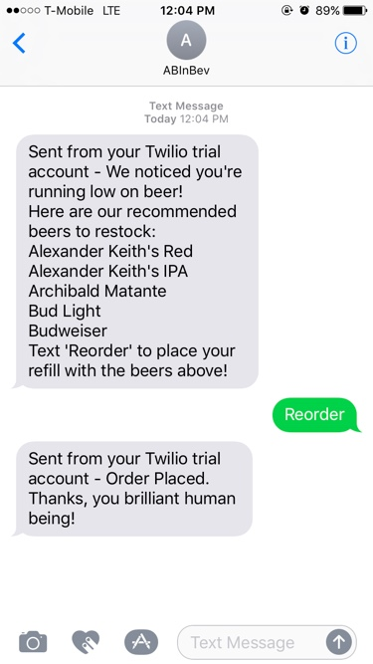

Slide 9
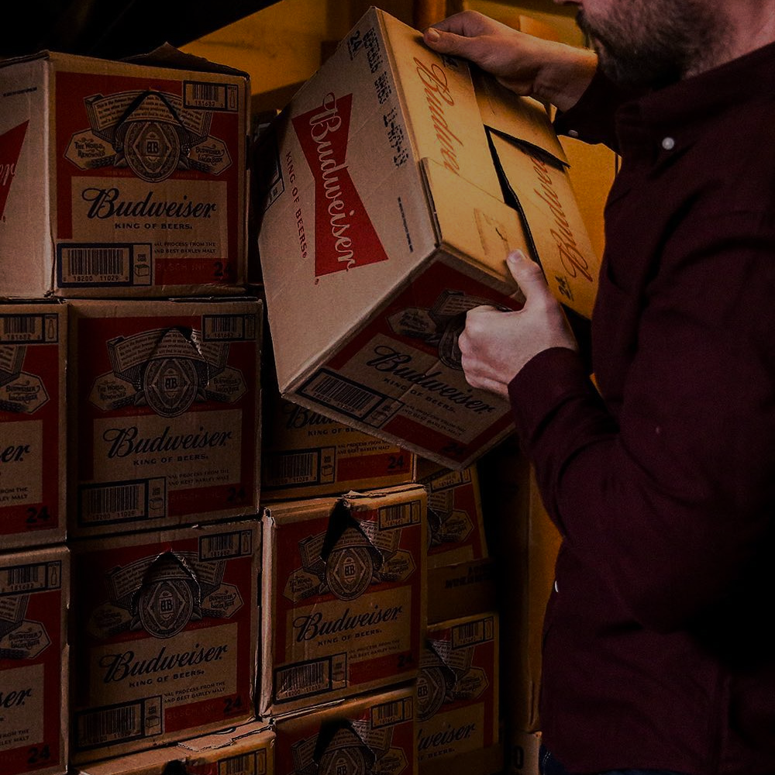
TapSwitch
Python
Openweathermap API
Twillio API
ABInBev Data
The Stack

Slide 10

Version 2.0:
Build in prediction triggers for major events by region
Order Quantity Prediction
Prediction by venue type

Slide 11
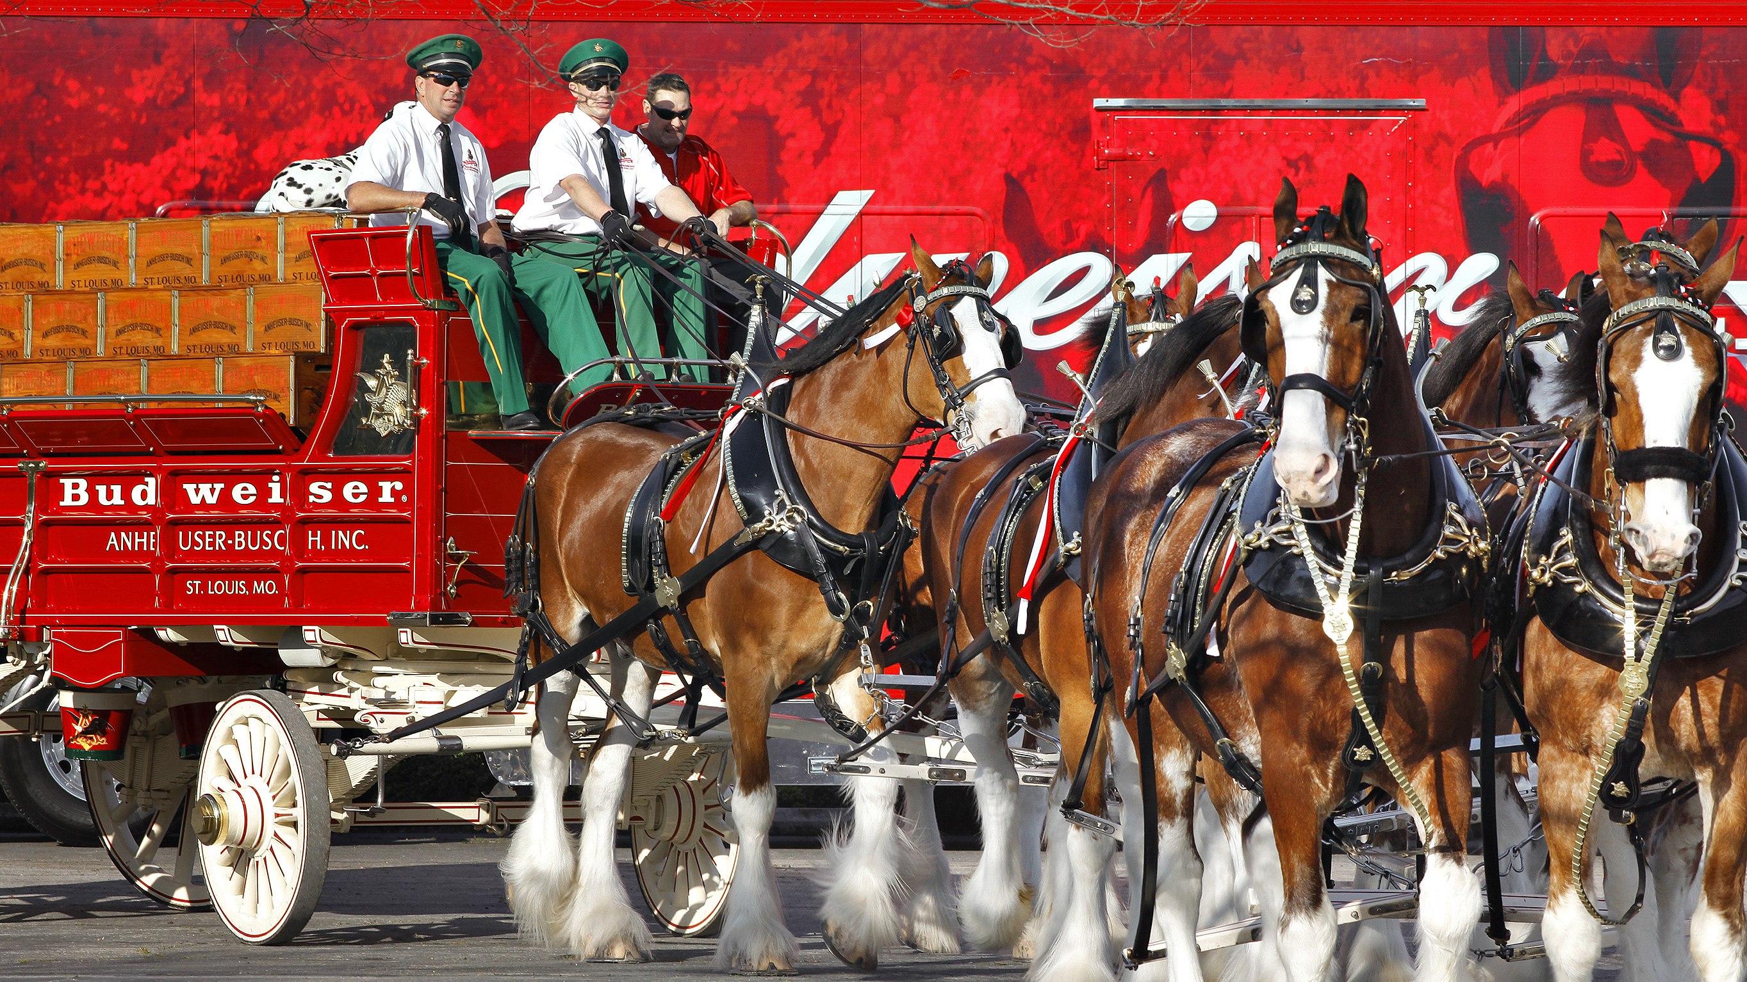
Thank You!

Slide 12
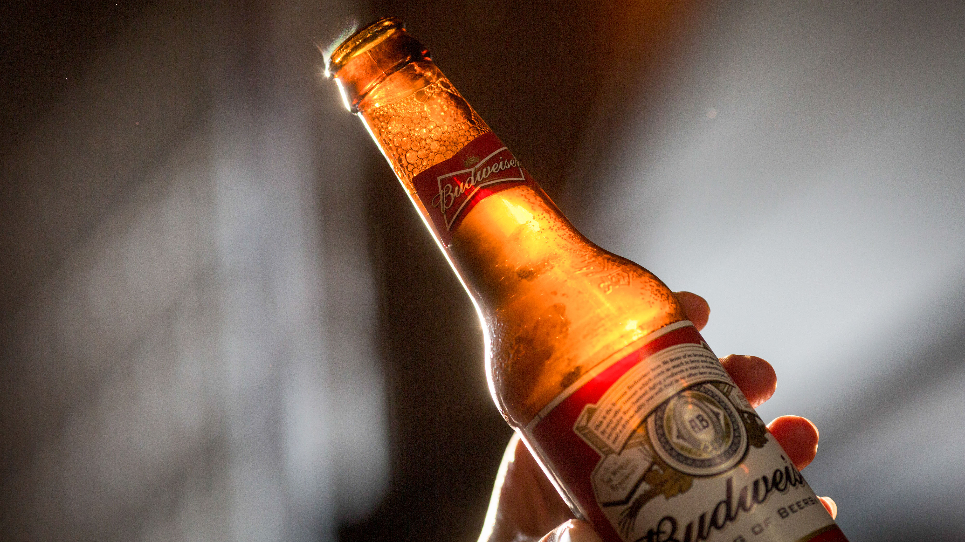
Questions?

Slide 14
EXTERNAL API SOURCES
Weather API -predicting consumption based off of weather forecast
Holiday API —predicting consumption based off of major holidays when consumption can be referenced from historic data
Sporting Event API -predicting consumption based off of major sporting events when consumption is predicted to be high

